Slide 1
Logistic Regression

Slide 2
Definition
In statistics, the logistic model (or logit model) is a statistical model that models the probability of an event taking place by having the log-odds for the event be a linear combination of one or more independent variables.

Slide 3
Logistic Regression is a classification model.
It can tell you the probability of a team winning, of a patient being healthy.
Logistic regression is used in various fields, including machine learning, most medical fields, and social sciences. For example, the Trauma and Injury Severity Score (TRISS), which is widely used to predict mortality in injured patients, was originally developed by Boyd et al. using logistic regression. Many other medical scales used to assess severity of a patient have been developed using logistic regression.
Logistic regression may be used to predict the risk of developing a given disease (e.g. diabetes; coronary heart disease), based on observed characteristics of the patient (age, sex, body mass index, results of various blood tests, etc.).
Another example might be to predict whether a Nepalese voter will vote Nepali Congress or Communist Party of Nepal or Any Other Party, based on age, income, sex, race, state of residence, votes in previous elections, etc.
The technique can also be used in engineering, especially for predicting the probability of failure of a given process, system or product. It is also used in marketing applications such as prediction of a customer's propensity to purchase a product or halt a subscription, etc.
In economics, it can be used to predict the likelihood of a person ending up in the labor force, and a business application would be to predict the likelihood of a homeowner defaulting on a mortgage. Conditional random fields, an extension of logistic regression to sequential data, are used in natural language processing.

Slide 4
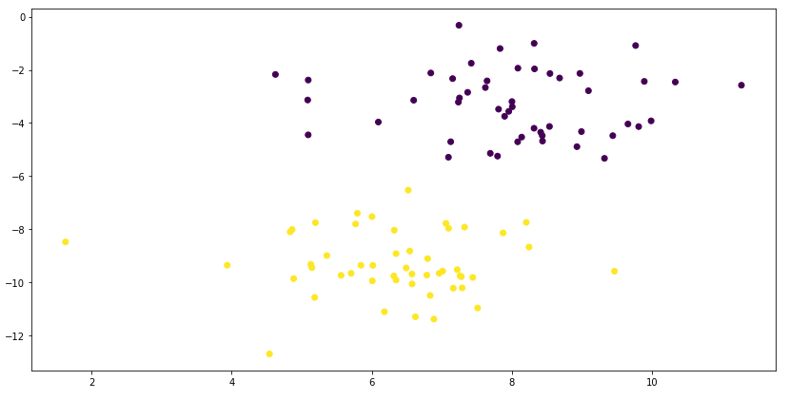
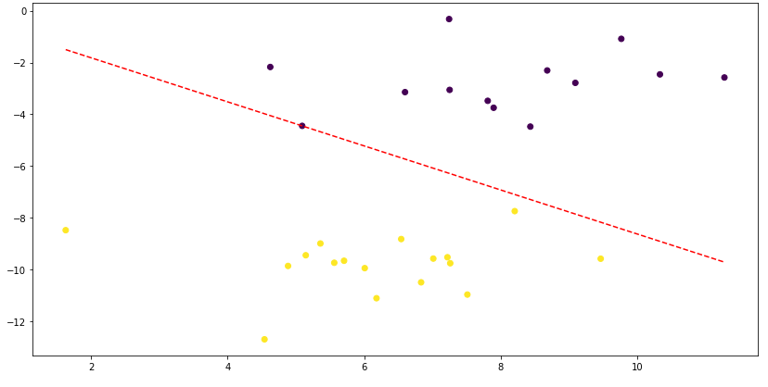
Logistic Regression is a linear model.
For Logistic Regression to be able to work, the data should be linearly separable.

Slide 5
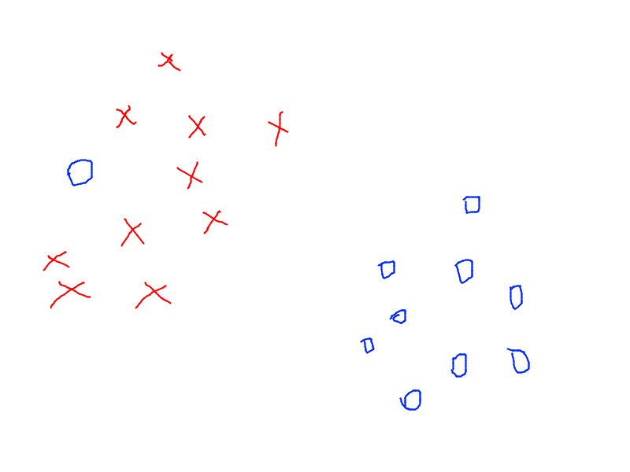
On a side note: An exaple of inseparable data
(Data with noise or errors)
Here, you can see that a blue circle is literally on the wrong side. It could be due to noise or error in the data.

Slide 6
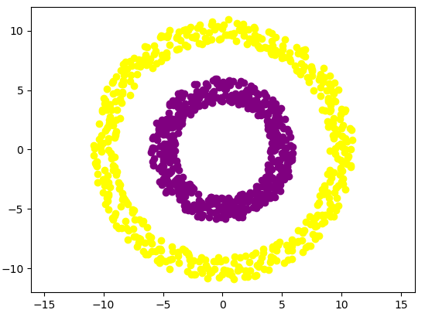
On a side note: Some examples of non-linearly separable data
(Concentric Rings)

Slide 7
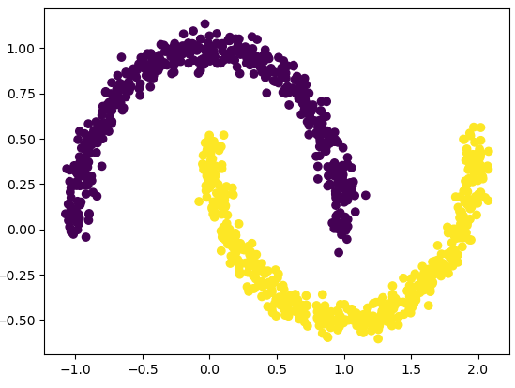
On a side note: Some examples of non-linearly separable data
(Interleaving Moons)

Slide 8
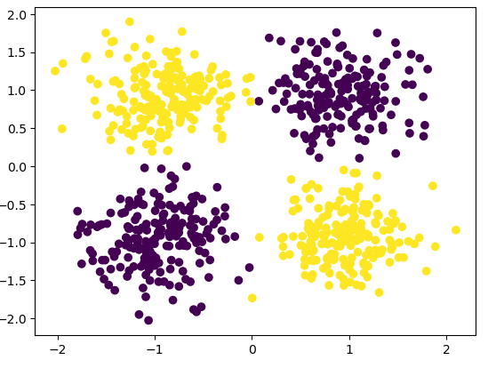
On a side note: Some examples of non-linearly separable data
(Checkboard like blobs)

Slide 9
Logistic Regression is a supervised learning model.
Supervised learning (SL) is a machine learning paradigm for problems where the available data consists of labeled examples, meaning that each data point contains features (covariates) and an associated label. The goal of supervised learning algorithms is learning a function that maps feature vectors (inputs) to labels (output), based on example input-output pairs.
In simple terms, for the model to learn to differentiate between classes:
Some training data is available that shows what each class looks like in terms of the features.

Slide 10
On a side note: Steps involved in Supervised Learning
To solve a given problem of supervised learning, one has to perform the following steps:
1. Determine the type of training examples. Before doing anything else, the user should decide what kind of data is to be used as a training set. In the case of handwriting analysis, for example, this might be a single handwritten character, an entire handwritten word, an entire sentence of handwriting or perhaps a full paragraph of handwriting.
2. Gather a training set. The training set needs to be representative of the real-world use of the function. Thus, a set of input objects is gathered and corresponding outputs are also gathered, either from human experts or from measurements.
3. Determine the input feature representation of the learned function. The accuracy of the learned function depends strongly on how the input object is represented. Typically, the input object is transformed into a feature vector, which contains a number of features that are descriptive of the object. The number of features should not be too large, because of the curse of dimensionality; but should contain enough information to accurately predict the output.
4. Determine the structure of the learned function and corresponding learning algorithm. For example, the engineer may choose to use support-vector machines or decision trees.
5. Complete the design. Run the learning algorithm on the gathered training set. Some supervised learning algorithms require the user to determine certain control parameters. These parameters may be adjusted by optimizing performance on a subset (called a validation set) of the training set, or via cross-validation.
6. Evaluate the accuracy of the learned function. After parameter adjustment and learning, the performance of the resulting function should be measured on a test set that is separate from the training set.

Slide 11
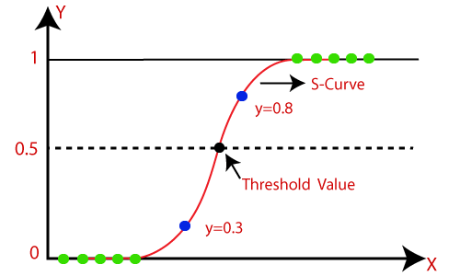
Logistic Regression is a probabilistic model.
Originally and basically, logistic regression is for binary classification.
But:
Binary variables can be generalized to categorical variables when there are more than two possible values (e.g. whether an image is of a cat, dog, lion, etc.), and the binary logistic regression generalized to multinomial logistic regression.
Logistic regression predicts the probability of seeing a categorical dependent variable, i.e., it gives the probabilistic values that lies between 0 and 1.
The curve from the logistic function indicates the likelihood of something such as whether the cells are cancerous or not, a mouse is obese or not based on its weight, etc.

Slide 12
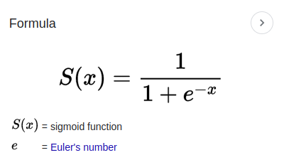
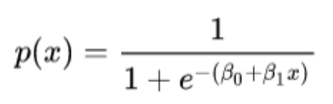
Side note: What is sigmoid function?
This function is used in logistic regression as shown below where in place of x, we have a linear combination of features and weights.

Slide 13
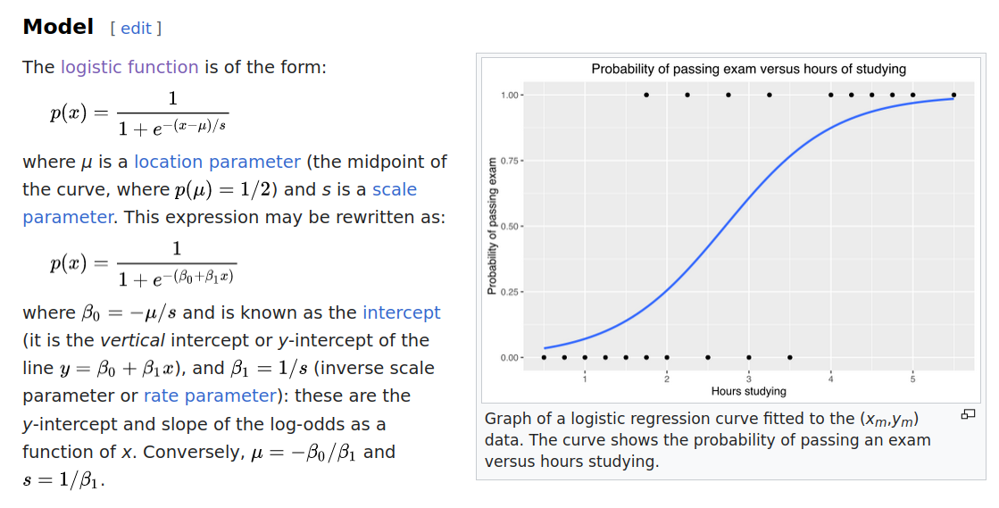
On a side note: What is logistic function?

